Slide 1

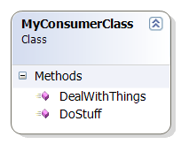
The class I’m working on…
… vs The Rest of the System

Slide 2
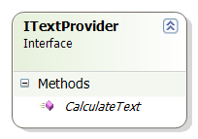
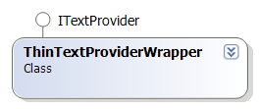
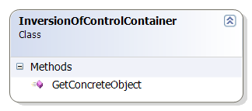
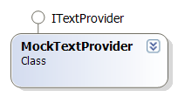
The class I’m working on…
…interacts with an interface
I defined, provided via
some mechanism…
…which returns either something testable (like a mock),
Or a thin façade or wrapper for the
“Legacy Code” implementation.

Slide 3
One unit of thought
Legacy Code gets smaller
and more manageable – walled off.

Slide 4



